Slide 1
MACHINE LEARNING TUTORIAL
Name

Slide 2


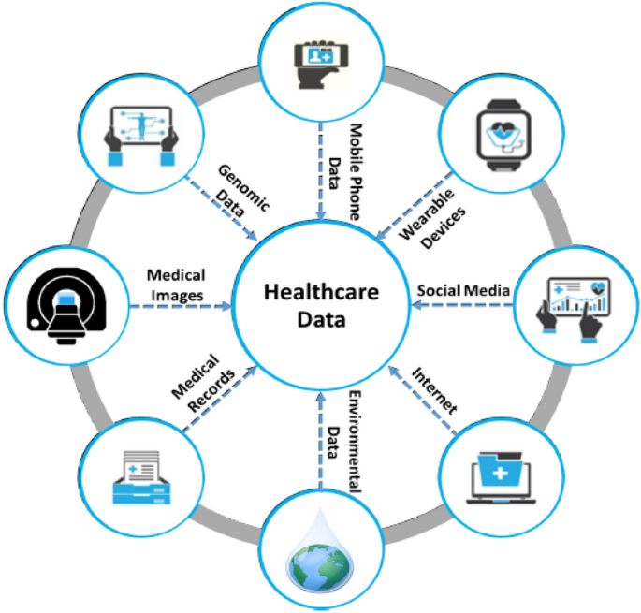
INTRODUCTION
Machine learning becomes the only way of forecasting diseases, diagnosing, and suggesting a course of action to be taken in the healthcare sector.
Increases in Internet use improve chronic conditions like diabetes.
Aim: To perform machine learning to diagnose, treat and predict diabetes through the analysis of a dataset.
Focus: It was forecasted and analysed using Logistic Regression, Random Forest, and SVM models.
Notes:
Machine learning has become one of the latest discoveries in healthcare by integrating the use of prediction models in diagnosis and treatment. This presentation also focuses on the outcomes of the machine learning strategies that include Logistic Regression, Random Forest, and SVM in predicting diabetes. To that end, the study uses Kaggle data set to establish feature importance and model accuracy while providing a prognosis into the modern developments in health diagnosis.

Slide 3
BACKGROUND AND TECHNIQUES OVERVIEW
It is evident that with ML, healthcare, especially disease diagnosis and management, is enhanced.
Diabetes and heart diseases are correctly diagnosed with the help of big data.
Techniques:
Logistic Regression: Binary classification tasks.
Random Forest is a method which enables decision tree ensemble to avoid overfitting.
SVM is separated with a hyperplane and classifies given data.
Notes:
Machine learning makes healthcare better due to accurate diagnosis and proper management of diseases. Logistic Regression predicts two categories: Random Forest uses a decision tree-based model to enhance stability, and SVM to find out the class that separates it using a hyperplane. It demonstrates that such techniques, such as those used in this diabetes dataset, could revolutionise the approach to healthcare.

Slide 4
DATASET OVERVIEW
Kaggle diabetes dataset: 768 rows, 10 columns.
01
The features include pregnancies, Glucose levels, BMI, family history and age.
02
Dependent variable: Diabetes outcome. A diabetic patient is coded 1, while a non-diabetic is coded 0.
03
Data is useful in predictive modelling, especially in the provision of healthcare services.
04
Notes:
The Kaggle diabetes data set consists of 10 variables with 8 independent variables, one target variable and one output variable, such as outcomes and has a total record of 768. Others include glucose level, BM, insulin and age, among others. But thanks to this dataset, many predictive features were presented to machine learning algorithms, which would help to search for the relationships and even possible indicators of diabetes.

Slide 5
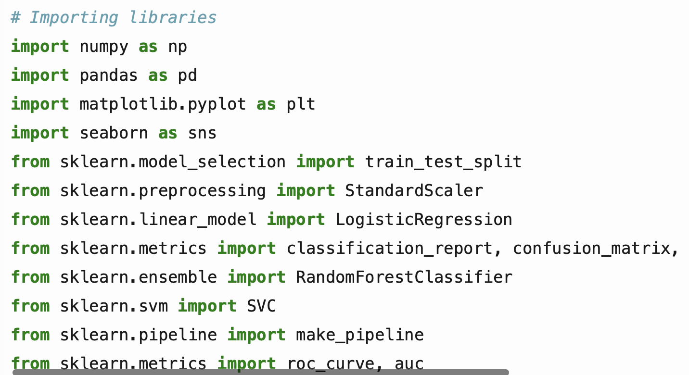
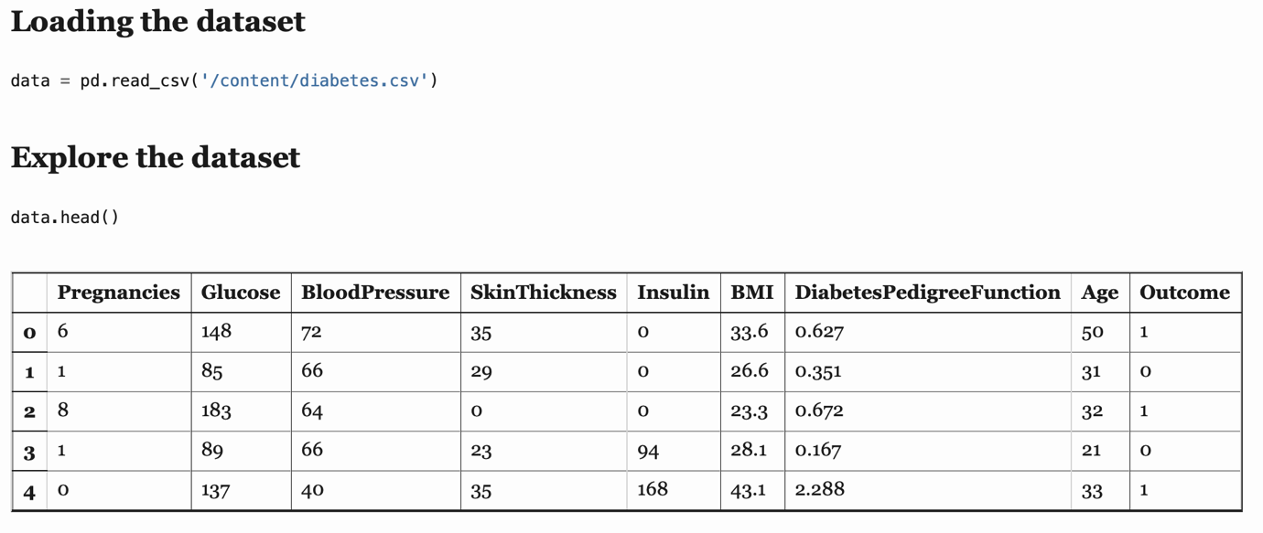
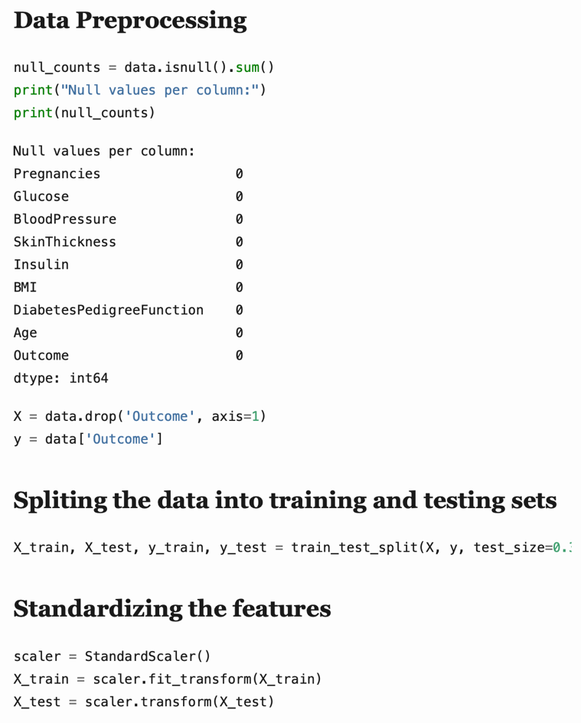
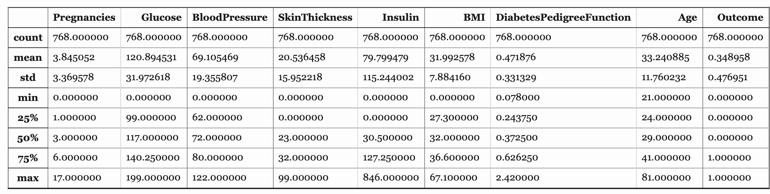
DATA PRE-PROCESSING
Averted zeros in features such as Glucose and skin thickness.
Normalised features using feature scaling/Normalization of all attributes with StandardScaler.
To use the model, performantly divide the dataset into 70% Training and 30% Testing.
Guaranteed the equal distribution of classes in the model for the purpose of the accurate model evaluation.
Notes:
Missing data and the normalisation and scaling of the features applied to the preprocessing of the data. Mean values were used to replace zeros present in attributes such as glucose and skin thickness. In order to maintain high MODEL VALIDATION, the dataset was divided into a training set of 70% and a testing set of 30%. StandardScaler standardised the features to a range between 0 & 1.

Slide 6
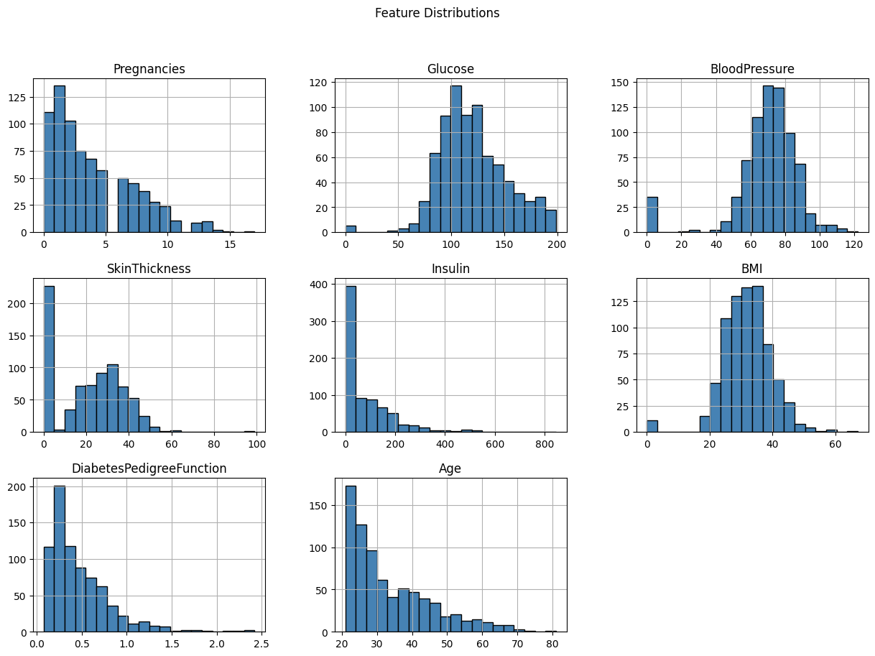
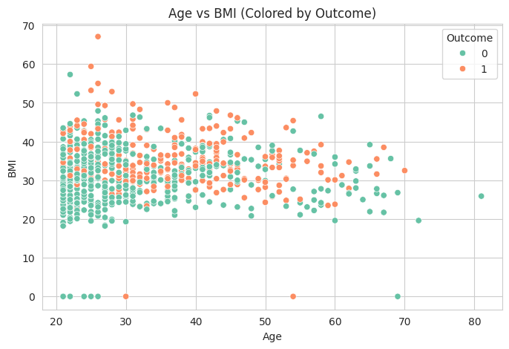
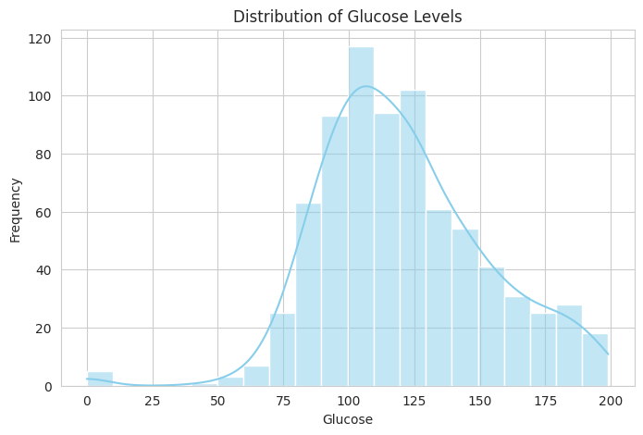
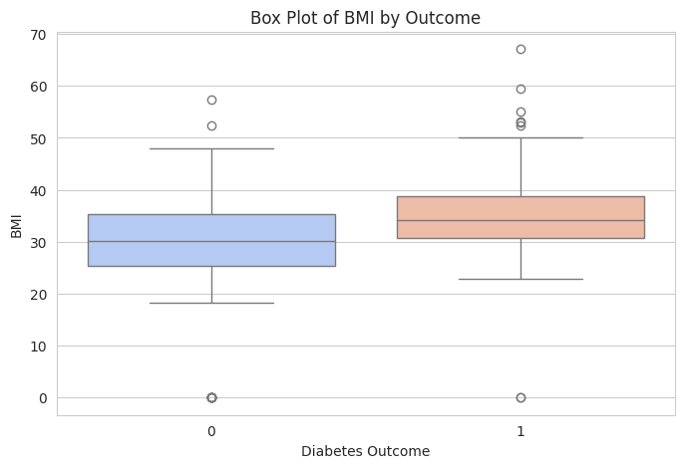
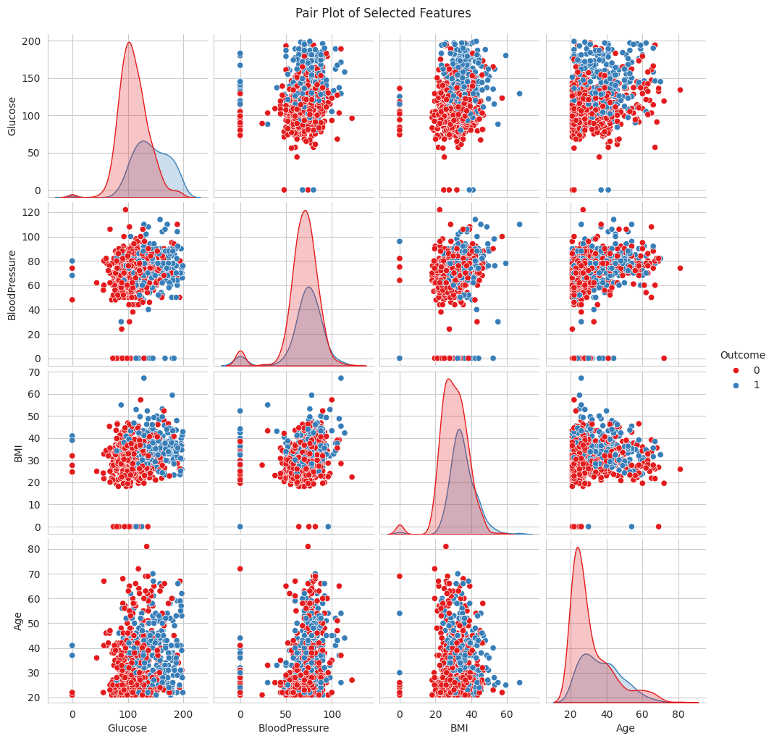
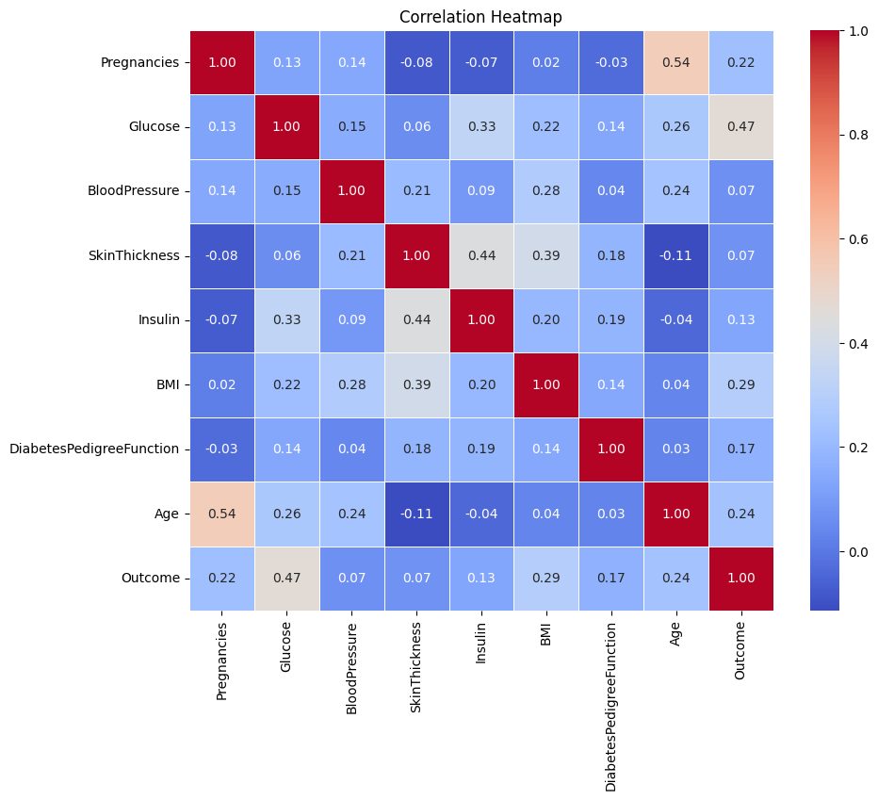
EXPLORATORY DATA ANALYSIS
Features are represented by the values, which are characterised by the presence of right-skewed distributions and outliers.
Blood sugar levels and BMI significantly affect the diabetes results.
Correlation heatmap: Glucose, BMI and age are the predicting factors. Worked on outliers such as skin thickness.
Notes:
Exploratory data analysis suggested that some data through skews of features such as glucose levels and BMI included outlying data. Gross and net AUC curves emphasised that patients with HbA1c, glucose, BMI, and SMBG had better diabetes outcomes than those with other factors. The correlation heat maps were also used to identify glucose, BMI, and age as the most important variables influencing the disease, hence being used to select the features to use when constructing the model.

Slide 7
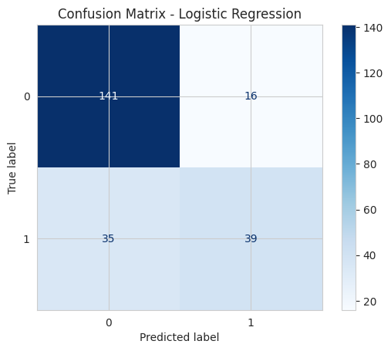
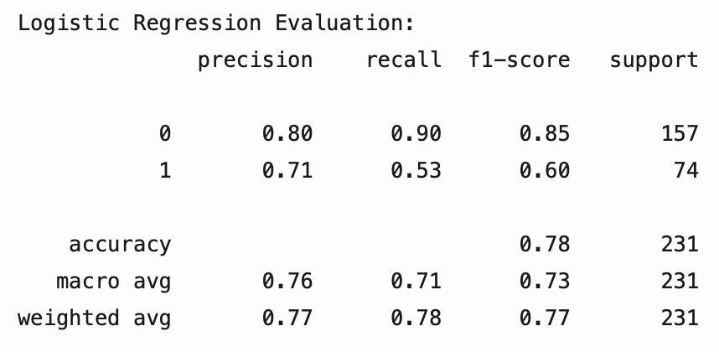
LOGISTIC REGRESSION PERFORMANCE
Accuracy: 78% higher precision when used in non-diabetic cases.
Parametrization tries to misclassify 35 diabetic cases; lower recall for class 1.
F1-score: 0.85 for non-diabetic individuals and 0.60 for diabetes.
The confusion matrix shows that the model has a tendency to predict class 0.
Notes:
Logistic Regression achieved 78% accuracy, with strong precision (0.80) for non-diabetic cases, but struggled with diabetic predictions (precision: 0.71). There were clear examples of misclassifications in the confusion matrices highlighted by over-performance in non-diabetic cases as compared to diabetics.

Slide 8

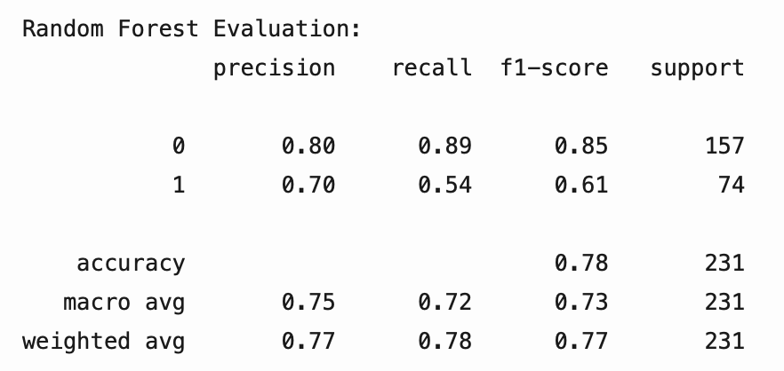
RANDOM FOREST PERFORMANCE
Accuracy: 78%; are resistant to overfitting.
Precision: 0.80: class 0 and 0.70: class 1.
It classifies fewer instances than the Logistic Regression model misclassifies.
Confusion matrix: Better in non-diabetic conditions.
Notes:
Random Forest proved to have similar accuracy (78 %) but was better equipped to deal with the imbalance of datasets. The model demonstrated acceptable accuracy for diagnosing non-diabetes cases (AUC = 0.80), albeit comparatively poor sensitivity for diabetic cases. Whereas ensemble techniques improved the outgoing reliability of the classifiers, there was a need to fine-tune class 1 recall.

Slide 9
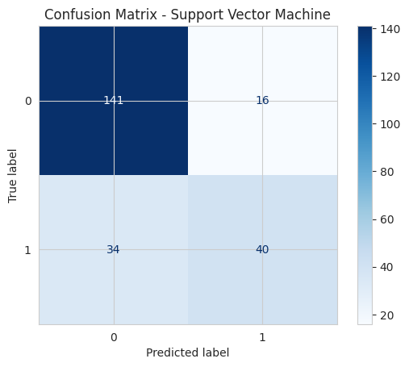
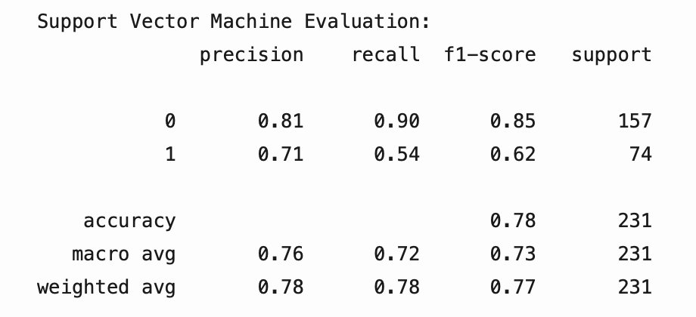
SVM PERFORMANCE
Accuracy: 77%, it is less effective than LG, RF, and SVM.
Precision: 0.81 (class 0), 0.71 (class 1).
ROC curve: This leads to a slightly lesser AUC compared to other models.
The challenges of diabetic prediction as with any other model.
Notes:
Since SVM scored the highest accuracy of 76%, its precision was impressive, particularly for non-diabetic classification, which was 0.81. However, similar to other models, its recall for the diabetic cases was poor (0.54). Hence, the overall small margin of differences showed the capability of effective classification between classes through ideal hyperplane placement.

Slide 10
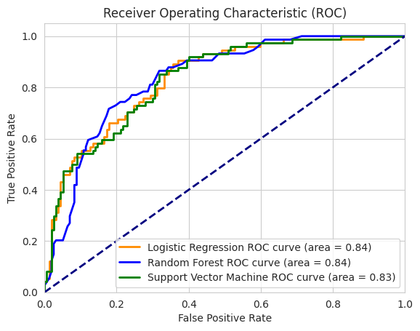
MODEL COMPARISON AND INSIGHTS
There is little difference in accuracy across models, and all models attain an accuracy of 76% to 78%.
Logistic Regression and Random Forest excel when compared to SVM.
ROC curves: AUC values close to 0.84.
Key features: Glucose, BMI, and age are significant in predicting value for diabetic patients’ drug discovery.
Improvements needed: The feature balancing and oversampling.
Notes:
Using ROC analysis, the models achieved similar AUC values (~0.84) with Logistic Regression and Random Forest marginally better than SVM. Findings highlighted glucose, BMI and age as core parameters. Feature engineering and data balancing are still important areas to focus on in an effort to improve the sensitivity of predictions of diabetic cases

Slide 11
CONCLUSION
The outcome of this study indicates that ML models are somewhat capable of envisaging diabetes outcomes with reasonable precision.
In Logistic Regression, Random Forest, and SVM, features that mark a patient is glucose level, BMI, and age.
There is a lack of adequate data techniques in the models that complement diabetic cases, therefore, poor performance.
Demonstrates the application of ML in healthcare with better potential in the future prognosis of patients.
Notes:
This work confirms the possibility of the enhanced optimal machine learning model to predict diabetes using features such as glucose, BMI, and age. Although it brought a percentage of accurate results between 76-78%, there are still problems in diagnosing diabetic cases. More detailed investigation of feature engineering at the higher levels, oversampling approaches to the dataset, and diversification of the dataset to more accurately reflect the healthcare diagnostic industry should be pursued in future work.

Slide 12
REFERENCES
Shah, A.R., Mathew, A.A., Karthikeyan, V. and Shanmugasundaram, V., 2024, August. Patient Health Classification Using Various Machine Learning Algorithms. In 2024 Control Instrumentation System Conference (CISCON)(pp. 1-6). IEEE.
Shiwlani, A., Khan, M., Sherani, A.M.K., Qayyum, M.U. and Hussain, H.K., 2024. REVOLUTIONIZING HEALTHCARE: THE IMPACT OF ARTIFICIAL INTELLIGENCE ON PATIENT CARE, DIAGNOSIS, AND TREATMENT. JURIHUM: Jurnal Inovasi dan Humaniora, 1(5), pp.779-790.
Testas, A., 2023. Support Vector Machine Classification with Pandas, Scikit-Learn, and PySpark. In Distributed Machine Learning with PySpark: Migrating Effortlessly from Pandas and Scikit-Learn (pp. 259-280). Berkeley, CA: Apress.
Zollanvari, A., 2023. Supervised Learning in Practice: the First Application Using Scikit-Learn. In Machine Learning with Python: Theory and Implementation (pp. 111-131). Cham: Springer International Publishing.
Javaid, M., Haleem, A., Singh, R.P., Suman, R. and Rab, S., 2022. Significance of machine learning in healthcare: Features, pillars and applications. International Journal of Intelligent Networks, 3, pp.58-73.
Khosravi, P., Vergari, A., Choi, Y., Liang, Y. and Broeck, G.V.D., 2020. Handling missing data in decision trees: A probabilistic approach. arXiv preprint arXiv:2006.16341.

Slide 13
THANKS!

